Slide 1



Slide 2
2.ITS ABOUT TIME
CONTENT:
. ABOUT CALENDAR
. TRACKING OF EVENTS
. FESTIVALS AND CELEBRATIONS
. IMPORTANT DATES IN A YEAR
. TIMESLINES AND CHRONOLOGY.
CHAPTER 2/KARUNAMBIGAI/SOCIAL DEPT/SNS ACADEMY

Slide 3
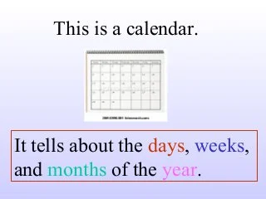
2.IT’S ABOUT TIME
Chapter 2 /SOCIAL Dept/n karunambigai/SNS academy

Slide 4
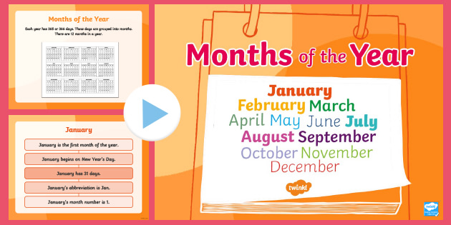
MONTHS OF THE YEAR

Slide 5
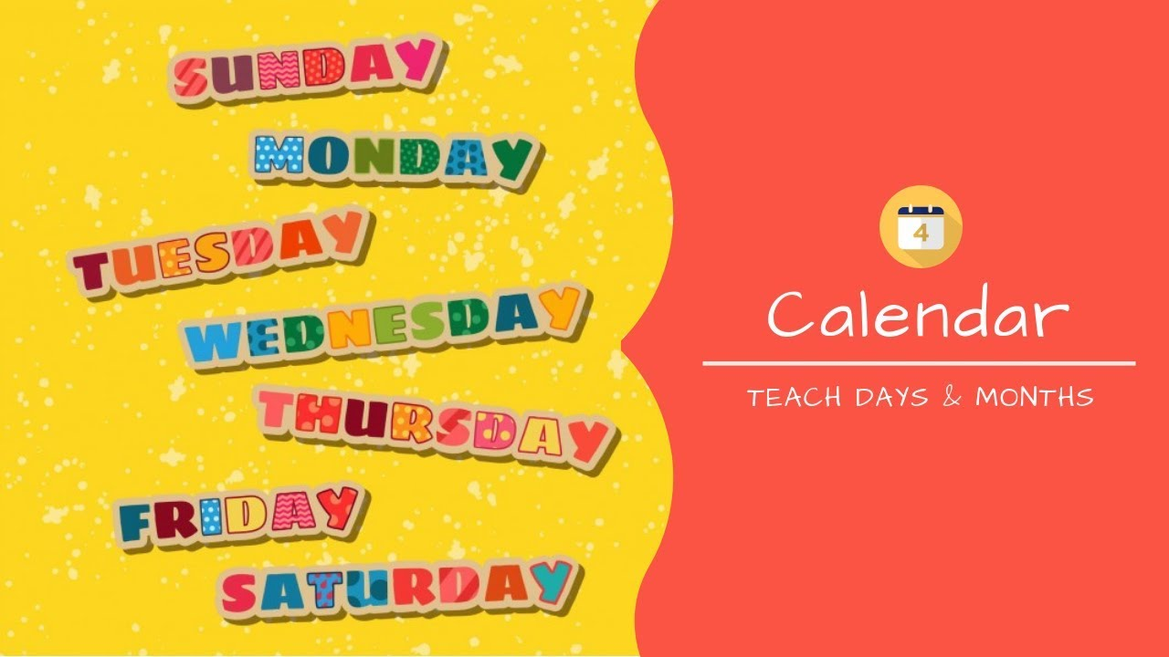
CHAPTER2/KARUNAMBIGAI/SOCIAL DEPT/SNS ACADEMY
DAYS OF THE WEEK

Slide 6
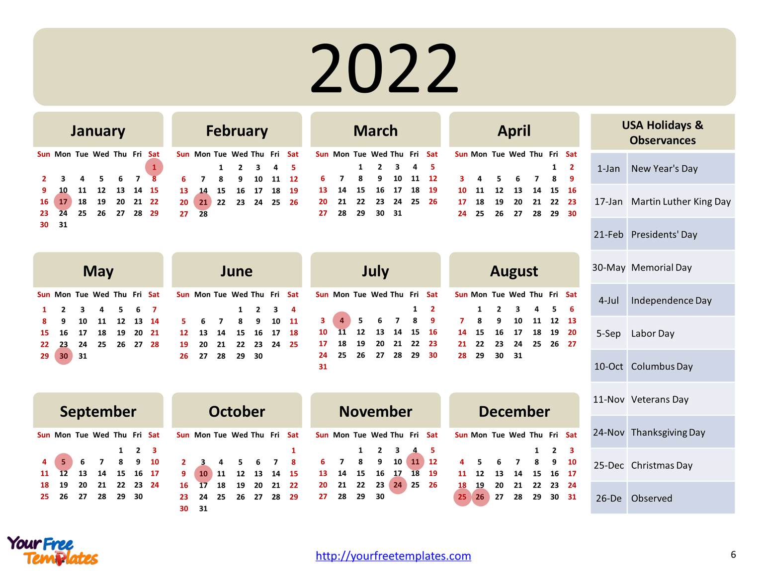
CALENDAR-2022

Slide 7
Chapter 2 /Social Dept/N karunambigai/SNS academy
CLASSIFICATIONS OF EVENTS
FAMILY EVENTS
SCHOOL EVENTS
NATIONAL EVENTS

Slide 8
CLASSIFICATION OF EVENTS
FAMILY EVENTS
BIRTHDAY, HOUSEWARMING,TEMPLES FESTIVAL.
NATIONAL EVENTS
REPUBLIC DAY
INDEPENDENCE DAY,
GANDHI JAYANTHI
SCHOOL EVENTS
ANNUAL DAY
SPORTS DAY
TEACHERS DAY

Slide 9
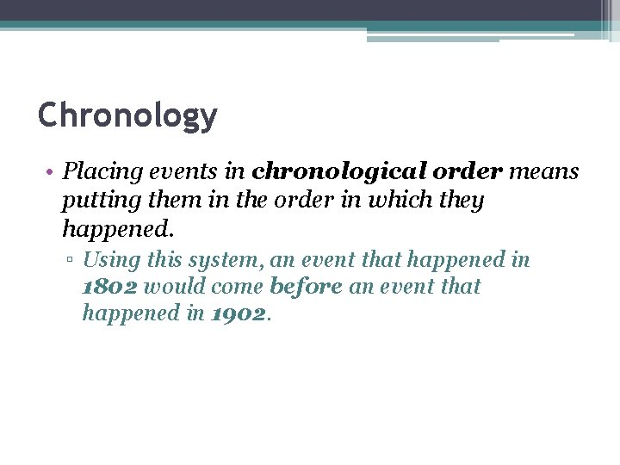
CHAPTER2/KARUNAMBIGAI/SOCIAL DEPT/SNS ACADEMY
CHRONOLOGICAL ORDER

Slide 10
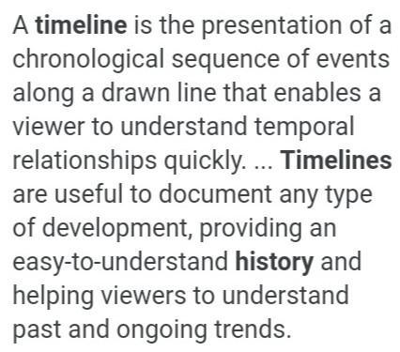
Chapter 2 /Social Dept/N karunambigai/SNS academy
TIMELINE

Slide 11
1.What is a timeline?
2.What are the different types of calendar?
3.Write the different phase of moon.
QUESTIONAIRES

Slide 12

EXAMPLES OF TIMELINE
CREATING A TIMELINE BY USING A LADDER.
INSERT THE YEAR AND EVENTS HAPPENED. IN SEQUENTIAL ORDER

Slide 13

Chapter 2 /Social Dept/N karunambigai/SNS academy

